Slide 1
Notes:
Thank mike
Disclaimer: My goal here is hopefully to add value.
Please be gentle, it’s my first time.

Slide 2
What’s with people actually liking JavaScript?

Slide 3
Some of you might be like…
Notes:
I’m on of those people
Never thought I would be.

Slide 4

Notes:
Why? I felt the same

Slide 5
JavaScript is pretty awesome!!!
Notes:
Your response might be something like

Slide 6
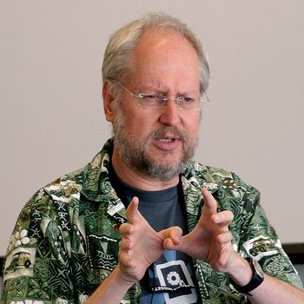
Douglas Crockford
Notes:
I started listing to this guy.
Before that I was like

Slide 7
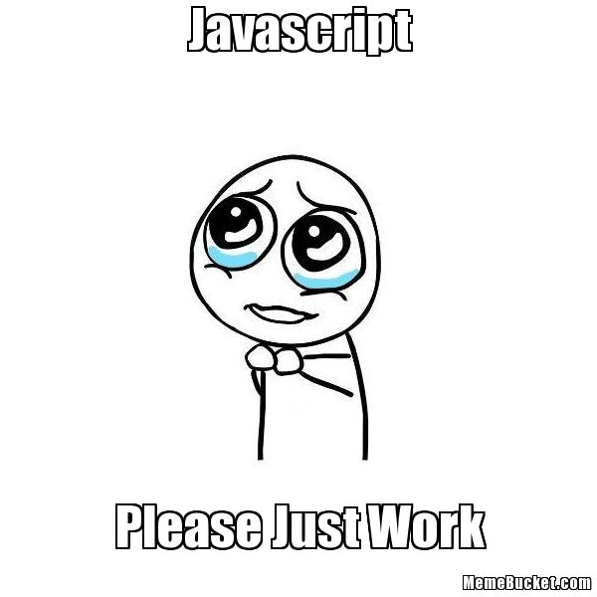
Notes:
Zk
Crockfor wrote a book

Slide 8
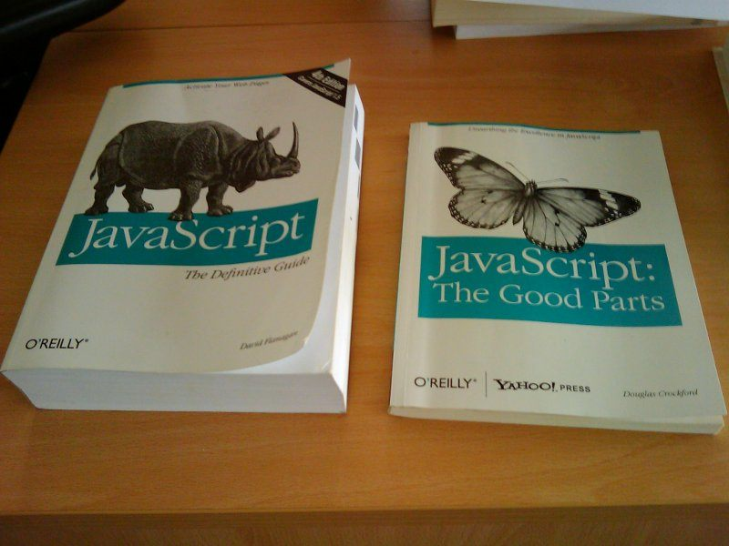
Notes:
Huge Contrast
He created a Linting tool to tell you about errors in your code
Javascript is interpreted, not compiled and it’s not type safe.

Slide 9

Brendan Eich
Notes:
Bredan Eich

Slide 10
But I can seriously say…

Slide 11
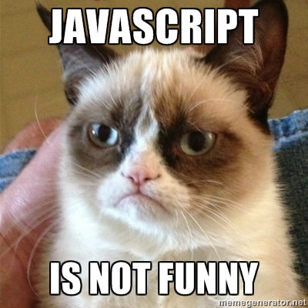

Slide 12
Is been making my mind feel like …

Slide 13
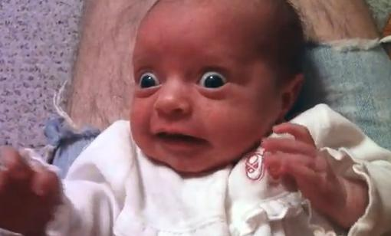
Notes:
So much to learn

Slide 14
So what’s the story…

Slide 15

Notes:
Trapped waiting for a prince

Slide 16
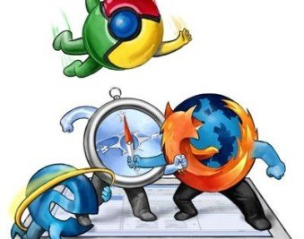
Notes:
In the browser wars

Slide 17
The other browser fought valiantly

Slide 18
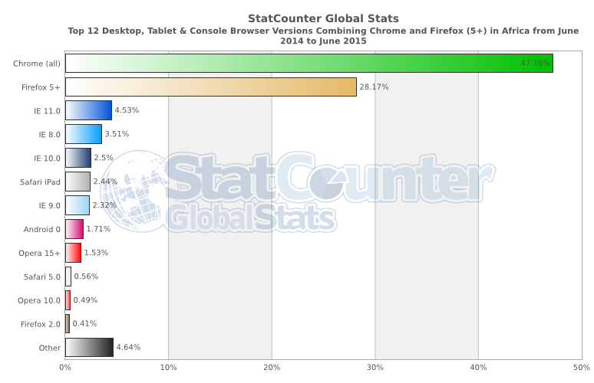

Slide 19
Everybody starts paying attention to more attention standards
Notes:
* As compition rises

Slide 20
On December 3, 2009, ECMA-262 5th edition was published
Notes:
- Trailing commas are ok
No reserved words for property names-
NaN, Infinity, undefined : are all constants- parseInt() defaults to radix 10
/regexp/ produces new reg ex object every time- JSON.parse(), JSON.stringify()
Function.prototype.bind
String.prototype.trim
Array.prototype.every, filter, forEach, indexOf, lastIndexOf, map, reduce, reduceRight, some,
Date.now()
Date.prototype.toISOString
new Date(string) and Date.parse(string) will try ISO format 1st
Array.isArray()
Object.keys()
Object.create()
Object.defineProperty
Object.defineProperties
Object.getOwnPropertyDescriptor()
Object.getOwnPropertyNames(obj)
Object.getPrototypeOf(obj)
Object.seal(),
Object.freeze(),
Object.preventExtensions()
Object.isSealed()
Object.isFrozen()
Object.isExtensible()
Property attributes: writeable, value, enumerable, configurable, get, set
'use strict';- Strict Mode: No more implied global variables within functions. this is not bound to the global object by function form. apply and call do not default to the global object. No with statement. Setting a writeable: false property will throw. Deleting a configurable: false property will throw. Restrictions on eval. eval and arguments are reserved. arguments not linked to parameters. No more arguments.caller or arguments.callee. No more octal literals. Duplicate names in an object literal or function parameters are a syntax error

Slide 21
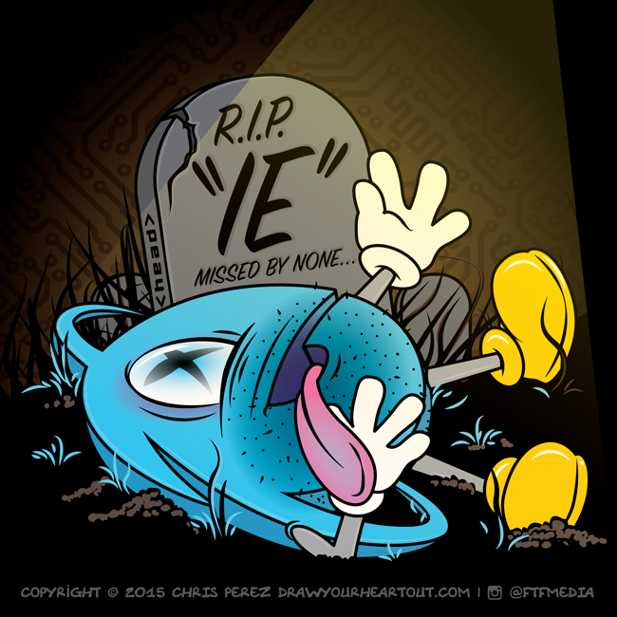
Notes:
Post mortem: Cause of death. No discipline in implementation lead to medical complications

Slide 22

New features every year

Slide 23

ES 6 Harmony
Notes:
Which means everybody is friends again. Google, facebook, mozilla, and Microsoft are working together to make javascript better
This started with the es 5 realease.

Slide 24
Now we are entering a new era…

Slide 25
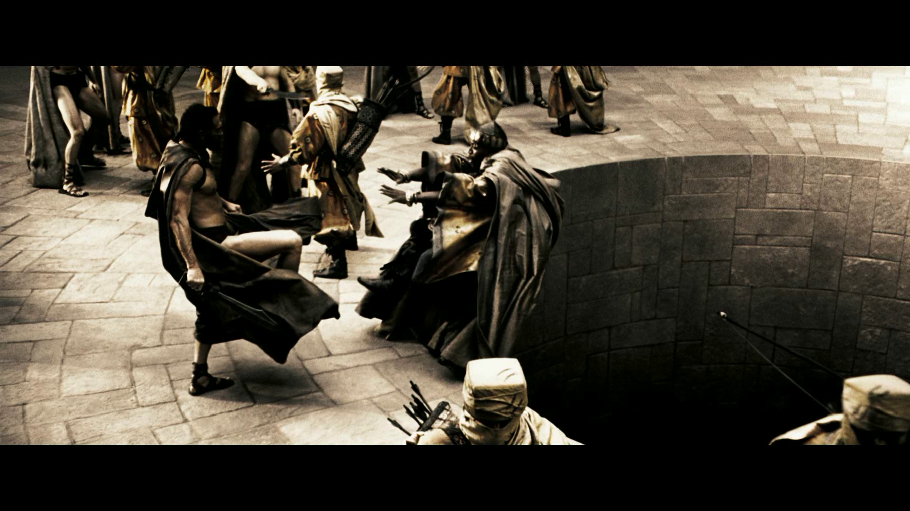
Enter a new era. This is JavaScript!!
This is JavaScript!

Slide 26
Why JavaScript?
Notes:
But first
Actual official name is Ecmascript
Why didn’t it just die.
3 possible reasons.

Slide 27

All the browsers support it
Notes:
At the explosion of the web, it was the only language.

Slide 28
It got functions right
Notes:
Isolation of concern
Really simple asynchronous programming

Slide 29
Almost never blocking, without you needing to know about multiple threads
Notes:
Well sort off

Slide 30
Web workers
Notes:
Separate thread, no shared state;
Long running computations

Slide 31
The fruit ES6 or ES2015
Modules
Promises
Classes
Cleaner Lambda Expressions Syntax
Iterator, so that you can loop through collections
Generators
New data-structure objects, map + set
String Literals
De-structuring Assignment
First class representation of a promise
Blocked scope variables
Notes:
Lambda expressions has always been available in javascript

Slide 32
What’s next? ES 2016 and beyond
Async Functions
Array Comprehension
Opt in SharedState for webworkers and Atomic operations
Opt in type safety, extenstion TypeScript
Macro’s

Slide 33

DI Frameworks

Slide 34

Sever Side JavaScript

Slide 35

Sonar

Slide 36
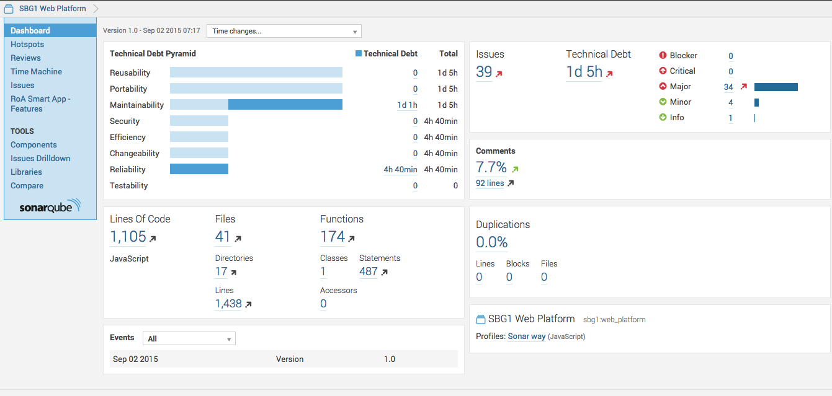

Slide 37
Test Coverage Tools
Notes:
Istanbul

Slide 38


Package Managers

Slide 39

Build Tools
Notes:
Evironmental property chagnes
Minification
Changing the project struct
Starting up a dev enivronment

Slide 40

Interactive Project Scaffolding
Notes:
Yeoman
Maven acrchitypes

Slide 41

Babel

Slide 42
Why does all of this matter so much?

Slide 43

Uncle Bob
Real name: Robert C Martin
Notes:
Called meeting that lead to the Signing of the Agile Manifesto. Pretty much started agile.
He has video titled The Last Programming Language.
Discipline applied to binary

Slide 44
Everybody in the world that cares about doing anything in the browser will most likely be adding features to JavaScript and those feature will be released every year
Notes:
- https://extensiblewebmanifesto.org/
- I’m not saying JavaScript is going to end other languages or be come the chosen one. But it ain’t going anywhere any time soon.

Slide 45
References
https://www.w3.org/community/webed/wiki/A_Short_History_of_JavaScript
http://wiki.ecmascript.org/doku.php?id=harmony:harmony
https://developer.mozilla.org/en-US/docs/Web/JavaScript/EventLoop
https://www.youtube.com/watch?v=8aGhZQkoFbQ
Notes:
https://www.lucidchart.com/invitations/accept/1dc4daba-a57e-414a-aa8b-773525db3848

